Slide 1
CSE 477: Introduction to Computer Security
Lecture – 6
Course Teacher: Dr. Md Sadek Ferdous
Assistant Professor, CSE, SUST
E-mail: ripul.bd@gmail.com

Slide 2
Outline
Crypto primitives
Classis crypto systems
Block cipher

Slide 3
Crypto primitives
Alice wants to send a message (plaintext P) to Bob
The communication channel is insecure and can be eavesdropped by an attacker Eve
The goal is to allow secure exchanges of messages between Alice and Bob in an insecure channel
Crypto to the rescue!

Slide 4
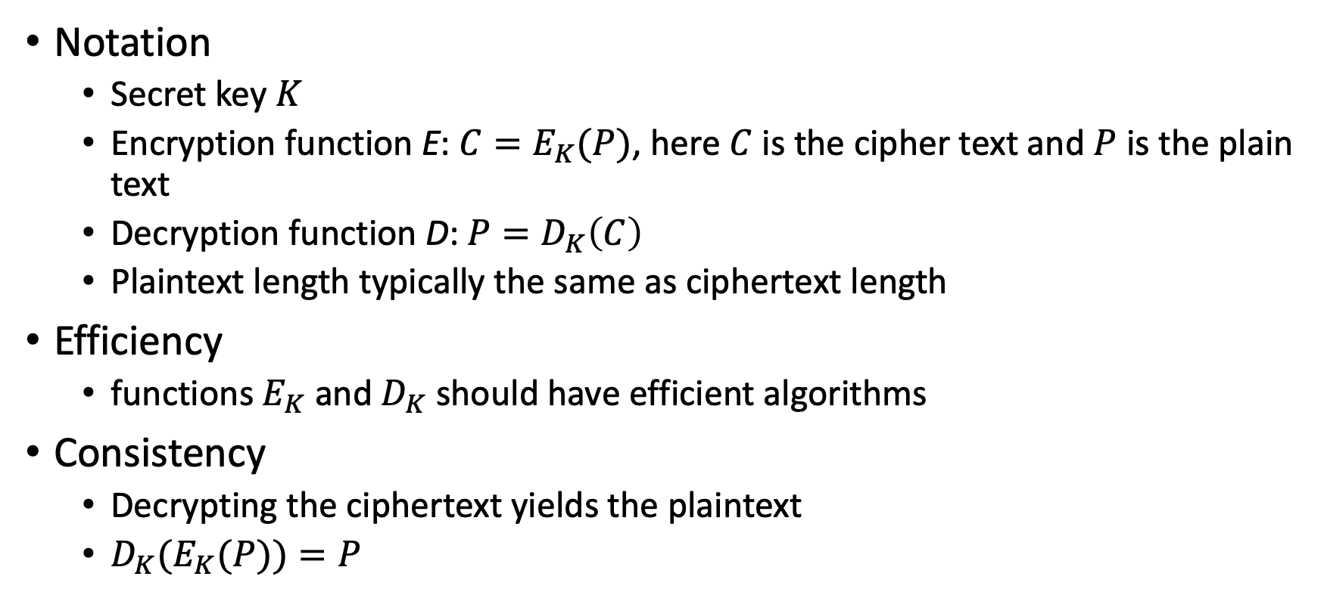
Crypto primitives
Notation
Secret key $K$
Encryption function E: ${C=E}_{K}(P)$, here $C$ is the cipher text and $P$ is the plain text
Decryption function D: ${P=D}_{K}\left(C\right)$
Plaintext length typically the same as ciphertext length
Efficiency
functions $E_{K}$ and $D_{K}$ should have efficient algorithms
Consistency
Decrypting the ciphertext yields the plaintext
${D_{K}(E}_{K}(P))=P$

Slide 5
Cryptosystem attacks
The science of attacking cryptosystems is known as cryptanalysis and its practitioners are called cryptanalysts
In performing cryptanalysis, we assume that the cryptanalyst knows the algorithms for encryption and decryption
only the keys used are secret
This assumption follows the open design principle
The concept of achieving security by obscurity (e.g. a cryptanalyst does not know anything about algorithms) is likely to fail
This because such information might leak in different ways:
internal company documents could be published or stolen,
a programmer who coded an encryption algorithm could be bribed or could voluntarily disclose the algorithm, or
the software or hardware that implements an encryption algorithm could be reverse engineered

Slide 6
Cryptosystem attacks
Ciphertext-only attack
In this attack, the cryptanalyst has access to the ciphertext of one or more messages, all of which were encrypted using the same key, K
His or her goal is to determine the plaintext for one or more of these ciphertexts or, better yet, to discover K
Known-plaintext attack
In this attack, the cryptanalyst has access to one or more plaintext-ciphertext pairs, such that each plaintext was encrypted using the same key, K
His or her goal in this case is to determine the key, K

Slide 7
Cryptosystem attacks
Chosen-plaintext attack
In this attack, the cryptanalyst can chose one or more plaintext messages and get the ciphertext that is associated with each one, based on the use of same key, K
In the offline chosen-plaintext attack, the cryptanalyst must choose all the plaintexts in advance
In the adaptive chosen-plaintext attack, the cryptanalyst can choose plaintexts in an iterative fashion, where each plaintext choice can be based on information he gained from previous plaintext encryptions

Slide 8
Cryptosystem attacks
Chosen-ciphertext attack
In this attack, the cryptanalyst can choose one or more ciphertext messages and get the plaintext that is associated with each one, based on the use of same key, K
As with the chosen-plaintext attack, this attack also has both offline and adaptive versions

Slide 9
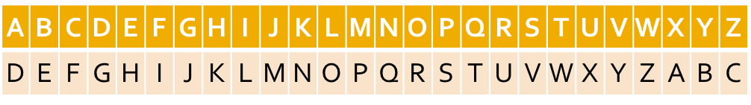
Classic cipher: Substitution cipher
Each letter is uniquely replaced by another
Caesar cipher is an example of a substitution cipher utilised by Julius Caesar:
Here, each letter in the plaintext is shifted three letters on right
When it reaches the end, it is wrapped back at the beginning
The decryption would require a three left shift
An example of a Caesar shift is given below:

Slide 10
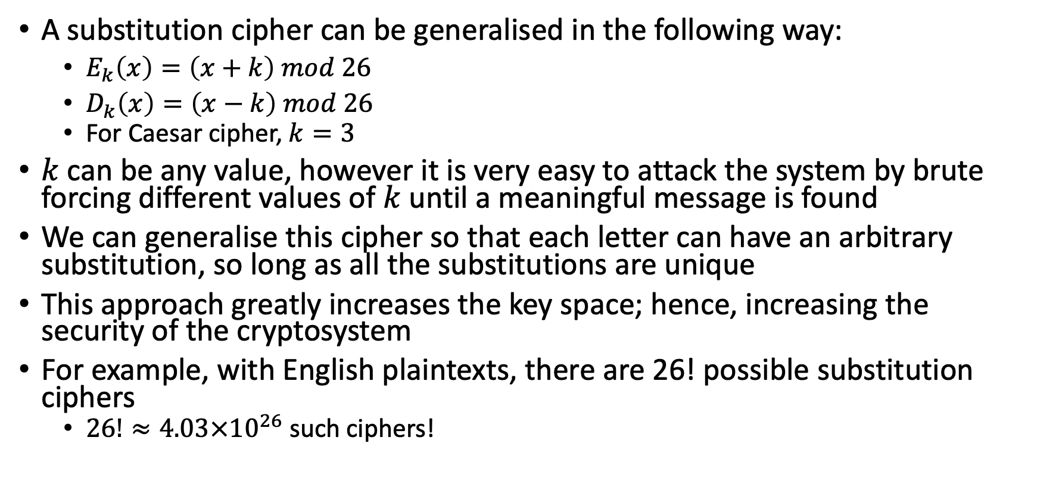
Classic cipher: Substitution cipher
A substitution cipher can be generalised in the following way:
$E_{k}\left(x\right)=\left(x+k\right) mod 26$
$D_{k}\left(x\right)=\left(x−k\right) mod 26$
For Caesar cipher, $k=3$
$k$ can be any value, however it is very easy to attack the system by brute forcing different values of $k$ until a meaningful message is found
We can generalise this cipher so that each letter can have an arbitrary substitution, so long as all the substitutions are unique
This approach greatly increases the key space; hence, increasing the security of the cryptosystem
For example, with English plaintexts, there are 26! possible substitution ciphers
$26!≈4.03×{10}^{26}$such ciphers!

Slide 11
Substitution cipher attack
Even with this huge key space, a substitution cipher can be easily broken
This is because letters in a natural language, like English, are not uniformly distributed
Knowledge of letter frequencies, including pairs and triples can be used in cryptologic attacks against substitution ciphers
For example, in English text, the letter “E” occurring just over 12% of the time, and “T” occurring less than 10% of the time
The most frequently occurring character in a ciphertext created from English substitution cipher probably corresponds to the letter E and so on

Slide 12
Substitution cipher attack

Slide 13
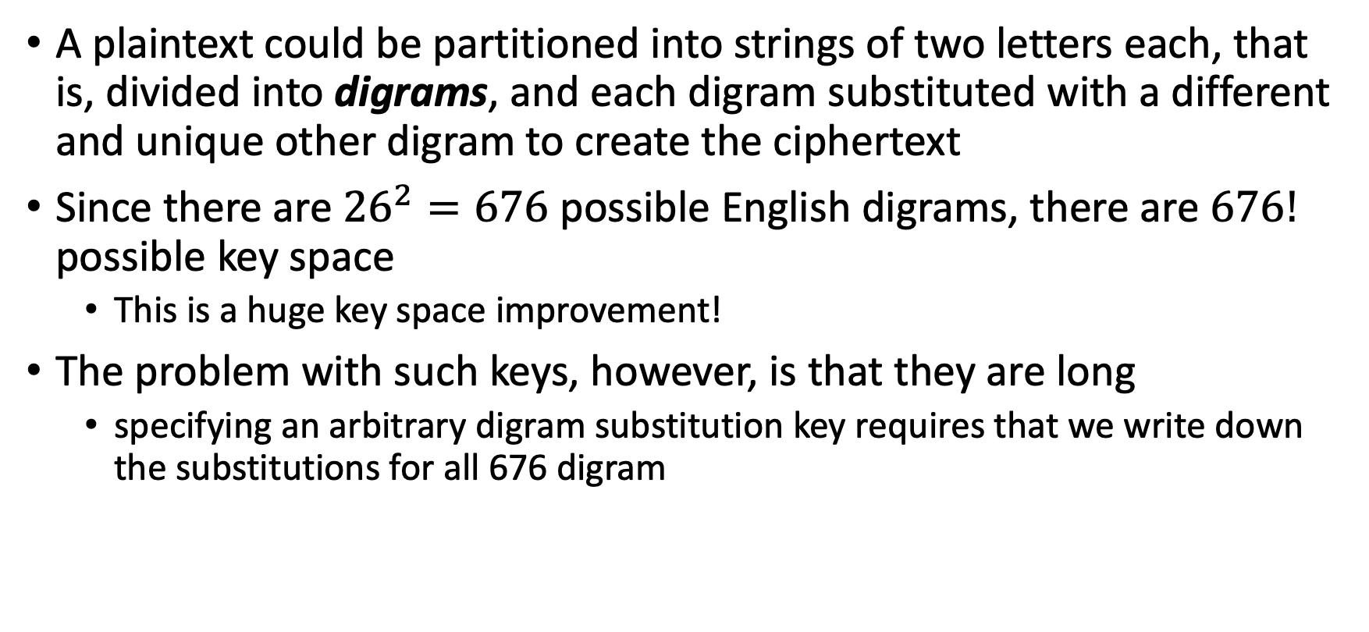
Polygraphic substitution cipher
A plaintext could be partitioned into strings of two letters each, that is, divided into digrams, and each digram substituted with a different and unique other digram to create the ciphertext
Since there are ${26}^{2}=676$ possible English digrams, there are $676!$ possible key space
This is a huge key space improvement!
The problem with such keys, however, is that they are long
specifying an arbitrary digram substitution key requires that we write down the substitutions for all 676 digram

Slide 14
Polygraphic substitution cipher
One easy way to express a digram substitution is using a two-dimensional table
In such a table, the first letter in a pair would specify a row, the second letter in a pair would specify a column, and each entry would be the unique two-letter substitution to use for this pair.
Such a specification is called a substitution box or S-box
This approach can be extended for binary values

Slide 15
Polygraphic substitution cipher
This approach can be extended for binary values

Slide 16
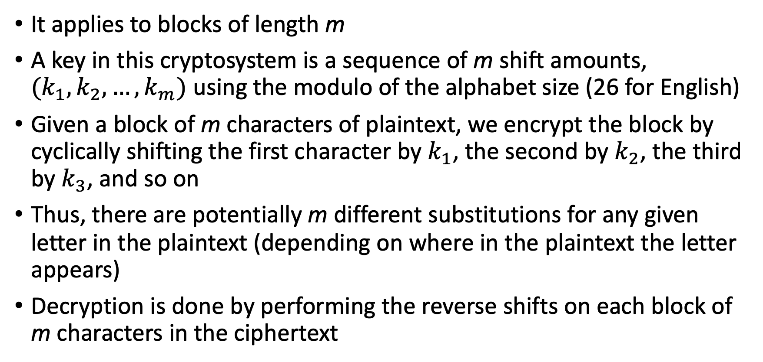
Classic cipher: Vigenère cipher
It applies to blocks of length m
A key in this cryptosystem is a sequence of m shift amounts, $(k_{1},k_{2},…,k_{m})$ using the modulo of the alphabet size (26 for English)
Given a block of m characters of plaintext, we encrypt the block by cyclically shifting the first character by $k_{1}$, the second by $k_{2}$, the third by $k_{3}$, and so on
Thus, there are potentially m different substitutions for any given letter in the plaintext (depending on where in the plaintext the letter appears)
Decryption is done by performing the reverse shifts on each block of m characters in the ciphertext

Slide 17
Vigenère cipher
Unfortunately, it can be easily broken using statistical techniques

Slide 18
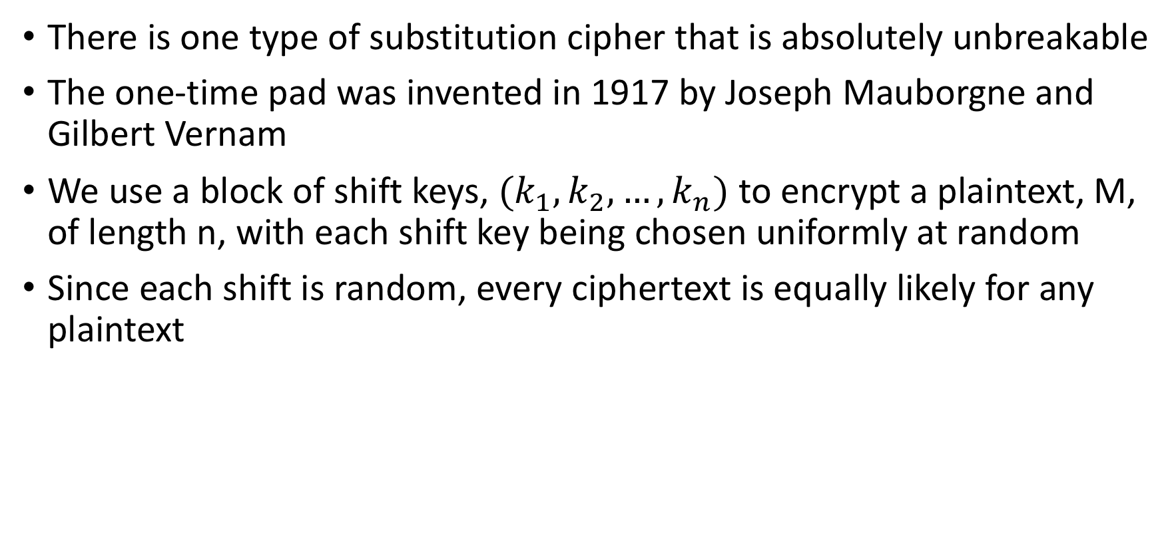
One-Time Pads
There is one type of substitution cipher that is absolutely unbreakable
The one-time pad was invented in 1917 by Joseph Mauborgne and Gilbert Vernam
We use a block of shift keys, $(k_{1},k_{2},…,k_{n})$ to encrypt a plaintext, M, of length n, with each shift key being chosen uniformly at random
Since each shift is random, every ciphertext is equally likely for any plaintext

Slide 19
One-Time Pads
In spite of their perfect security, one-time pads have some weaknesses
The key has to be as long as the plaintext
Keys can never be reused
Repeated use of one-time pads allowed the U.S. to break some of the communications of Soviet spies during the Cold War

Slide 20
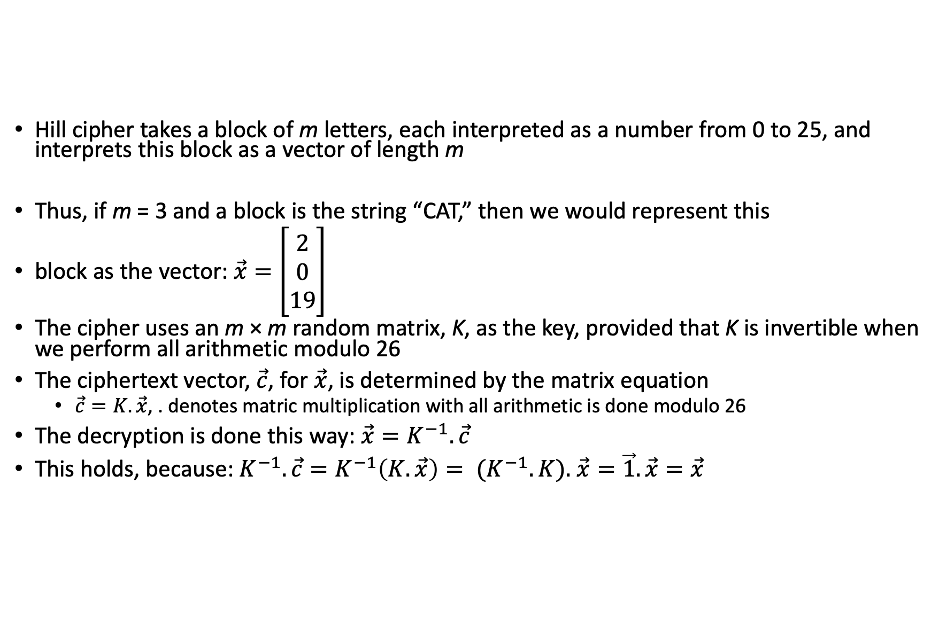
Classic cipher – Hill cipher
Hill cipher takes a block of m letters, each interpreted as a number from 0 to 25, and interprets this block as a vector of length m
Thus, if m = 3 and a block is the string “CAT,” then we would represent this
block as the vector: $\vec{x}=\left.\left[\begin{matrix}2 \\ 0 \\ 19\end{matrix}\right.\right]$
The cipher uses an m × m random matrix, K, as the key, provided that K is invertible when we perform all arithmetic modulo 26
The ciphertext vector, $\vec{c}$, for $\vec{x}$, is determined by the matrix equation
$\vec{c}=K.\vec{x}$, . denotes matric multiplication with all arithmetic is done modulo 26
The decryption is done this way: $\vec{x}=K^{−1}.\vec{c}$
This holds, because: $K^{−1}.\vec{c}=K^{−1}\left(K.\vec{x}\right)= {(K}^{−1}.K).$ $\vec{x}=\vec{1}.\vec{x}=\vec{x}$

Slide 21
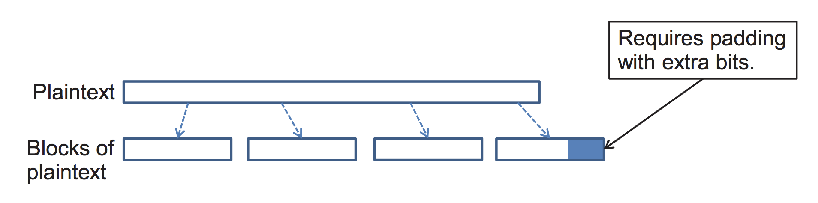
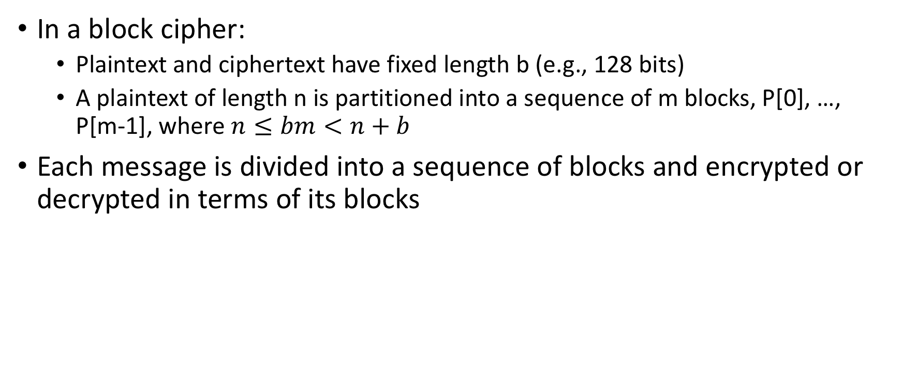
Block cipher
In a block cipher:
Plaintext and ciphertext have fixed length b (e.g., 128 bits)
A plaintext of length n is partitioned into a sequence of m blocks, P[0], …, P[m-1], where $n≤bm<n+b$
Each message is divided into a sequence of blocks and encrypted or decrypted in terms of its blocks

Slide 22
Padding
Block ciphers require the length n of the plaintext to be a multiple of the block size b
Padding the last block needs to be unambiguous (cannot just add zeroes)
When the block size and plaintext length are a multiple of 8, a common padding method (PKCS5) is a sequence of identical bytes, each indicating the length (in bytes) of the padding
Example for b = 128 (16 bytes)
Plaintext: “Roberto” (7 bytes)
Padded plaintext: “Roberto999999999” (16 bytes), where 9 denotes the number and not the character
We need to always pad the last block, which may consist only of padding
To remove any ambiguity if the message has a padding or not!

Slide 23
Modes of operation
There are several ways to use a block cipher, such as AES, that operate on fixed-length blocks
The different ways such an encryption algorithm can be used are known as its modes of operation
Four modes of operation:
Electronic Codebook (ECB) Mode
Cipher-Block Chaining (CBC) Mode
Cipher Feedback (CFB) Mode
Output Feedback (OFB) Mode

Slide 24
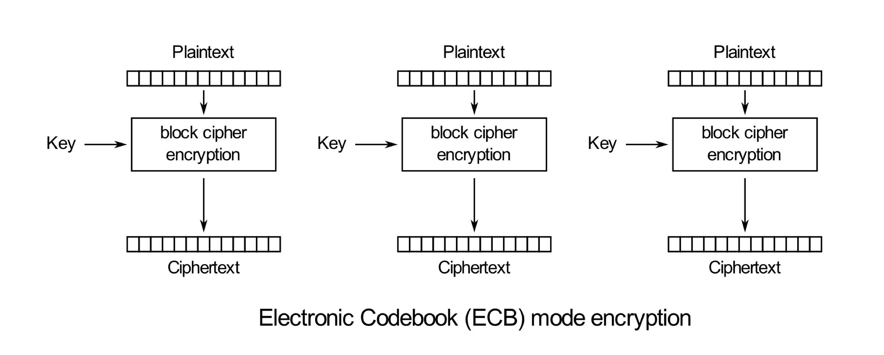
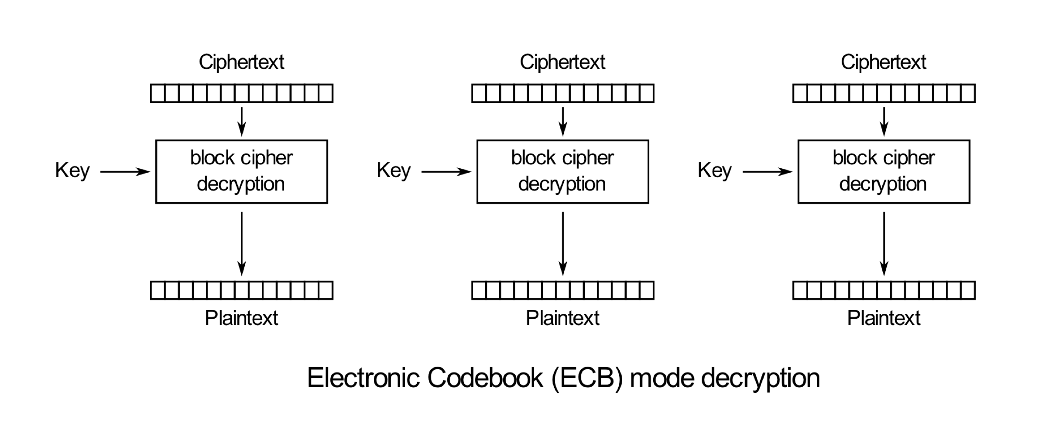

Electronic Codebook (ECB) Mode
This is the simplest mode
In this mode, the encrypting of the block, B_{i} is carried out according to the following formula: $C_{i}=E_{K}(B_{i})$
Likewise, the decryption is done using the following formula: $B_{i}=D_{K}(C_{i})$
Source: https://en.wikipedia.org/wiki/Block_cipher_mode_of_operation

Slide 25
Electronic Codebook (ECB) Mode: pros & cons
ECB mode works well with random strings (e.g., keys and initialization vectors) and strings that fit in one block
Documents and images are not suitable for ECB encryption since patters in the plaintext are repeated in the ciphertext
Example of image encrypted in ECB :

Slide 26
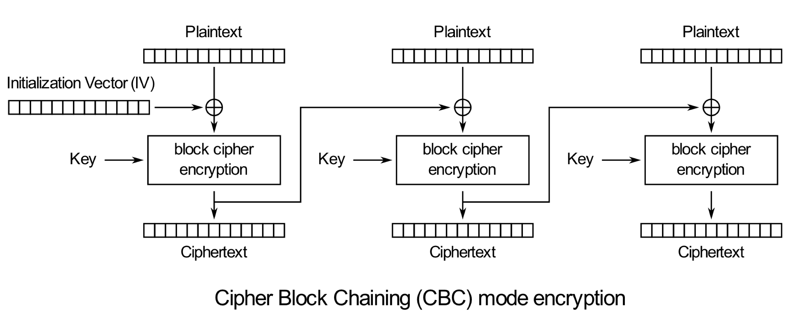
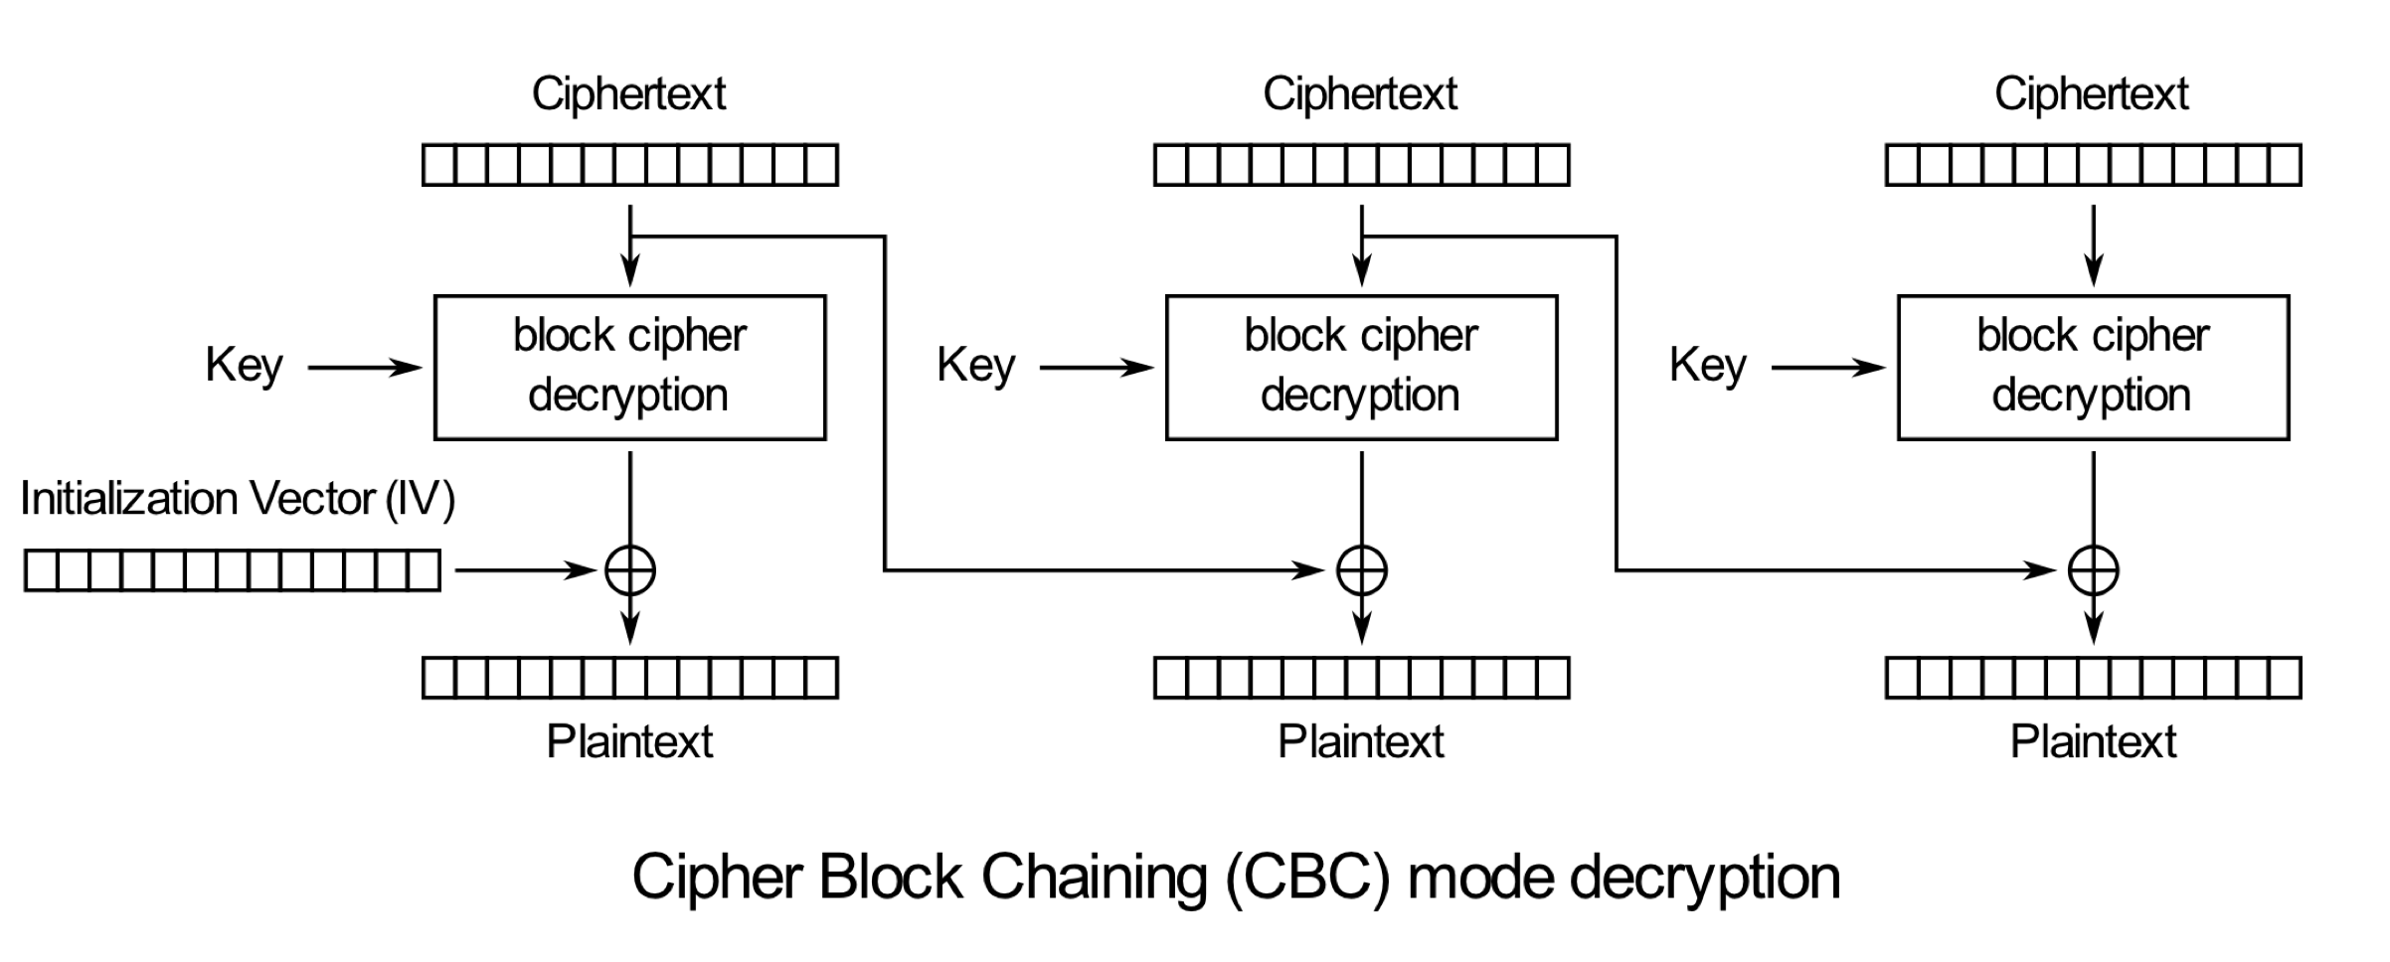
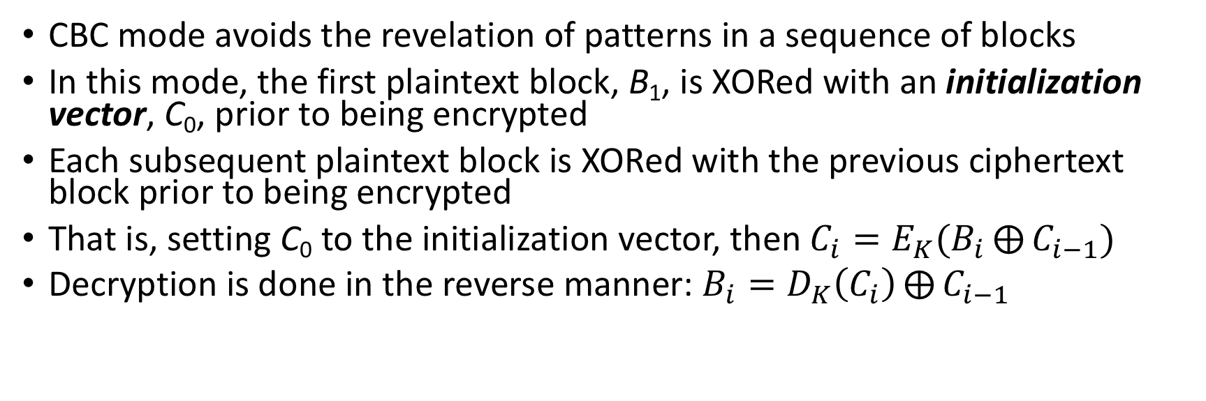
Cipher–block Chaining (CBC) Mode
CBC mode avoids the revelation of patterns in a sequence of blocks
In this mode, the first plaintext block, B₁, is XORed with an initialization vector, C₀, prior to being encrypted
Each subsequent plaintext block is XORed with the previous ciphertext block prior to being encrypted
That is, setting C₀ to the initialization vector, then $C_{i}=E_{K}(B_{i}⨁{C_{i−1}})$
Decryption is done in the reverse manner: $B_{i}=D_{K}\left(C_{i}\right)⨁{C_{i−1}}$
Source: https://en.wikipedia.org/wiki/Block_cipher_mode_of_operation

Slide 27
CBC Mode: pros & cons
Strengths:
Doesn’t show patterns in the plaintext
Is the most common mode
Is fast and relatively simple
Weaknesses:
CBC requires the reliable transmission of all the blocks sequentially
CBC is not suitable for applications that allow packet losses (e.g., music and video streaming)

Slide 28
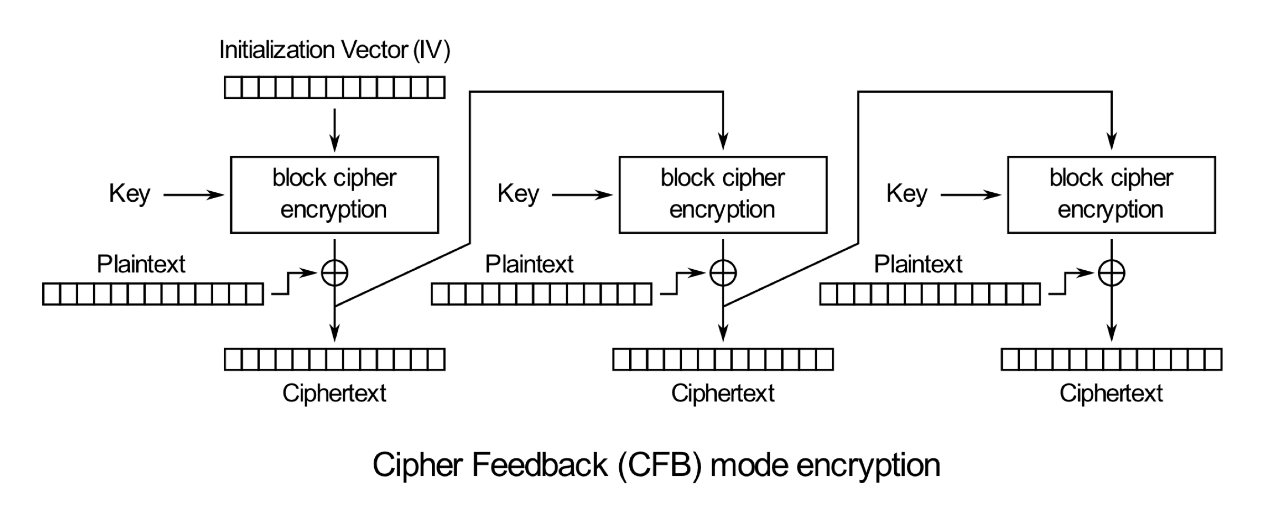
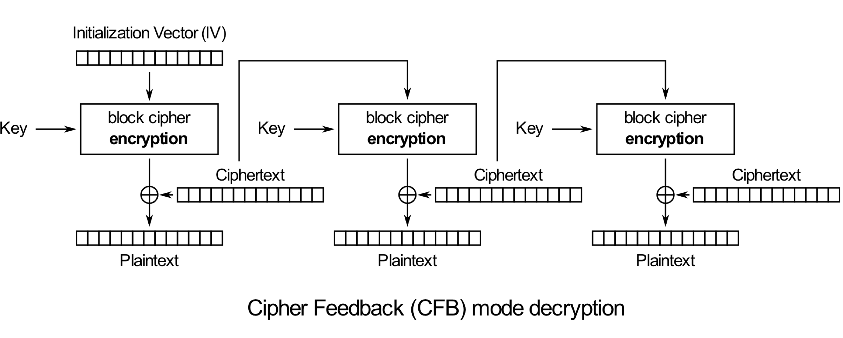
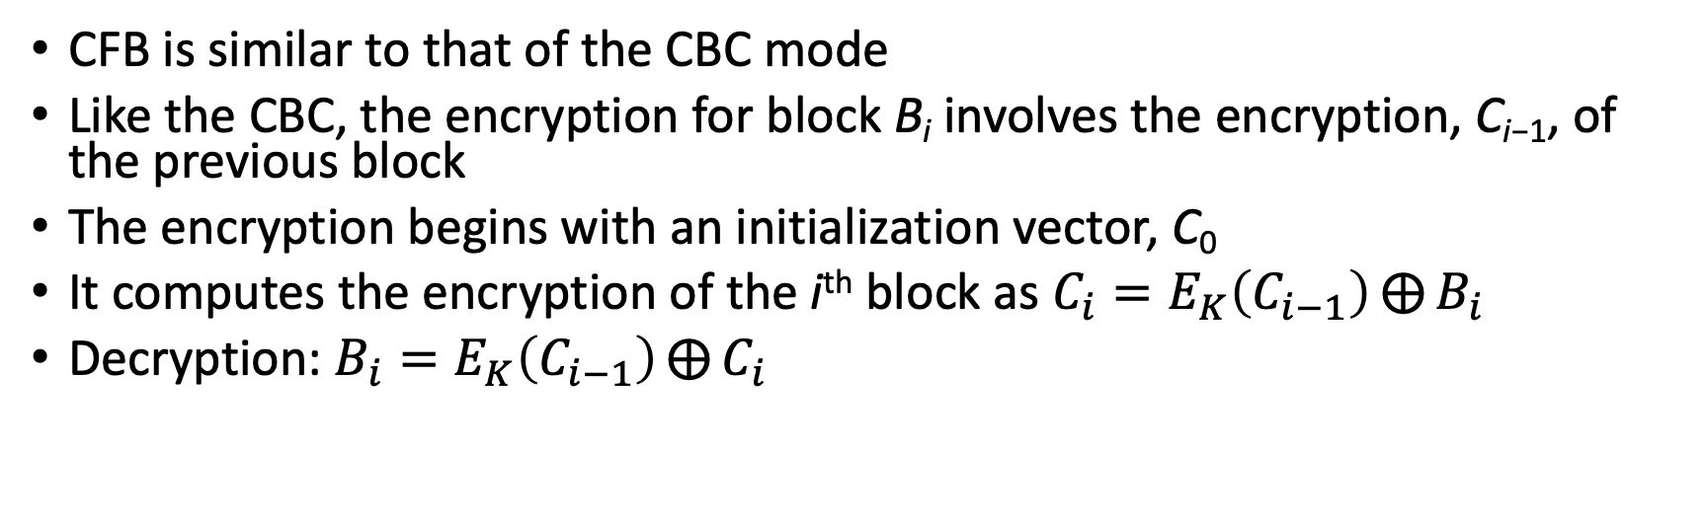
Cipher Feedback (CFB) Mode
CFB is similar to that of the CBC mode
Like the CBC, the encryption for block B_{i} involves the encryption, C_{i−1}, of the previous block
The encryption begins with an initialization vector, C₀
It computes the encryption of the i^{th} block as $C_{i}=E_{K}\left(C_{i−1}\right)⨁{B_{i}}$
Decryption: $B_{i}=E_{K}\left(C_{i−1}\right)⨁{C_{i}}$
Source: https://en.wikipedia.org/wiki/Block_cipher_mode_of_operation

Slide 29
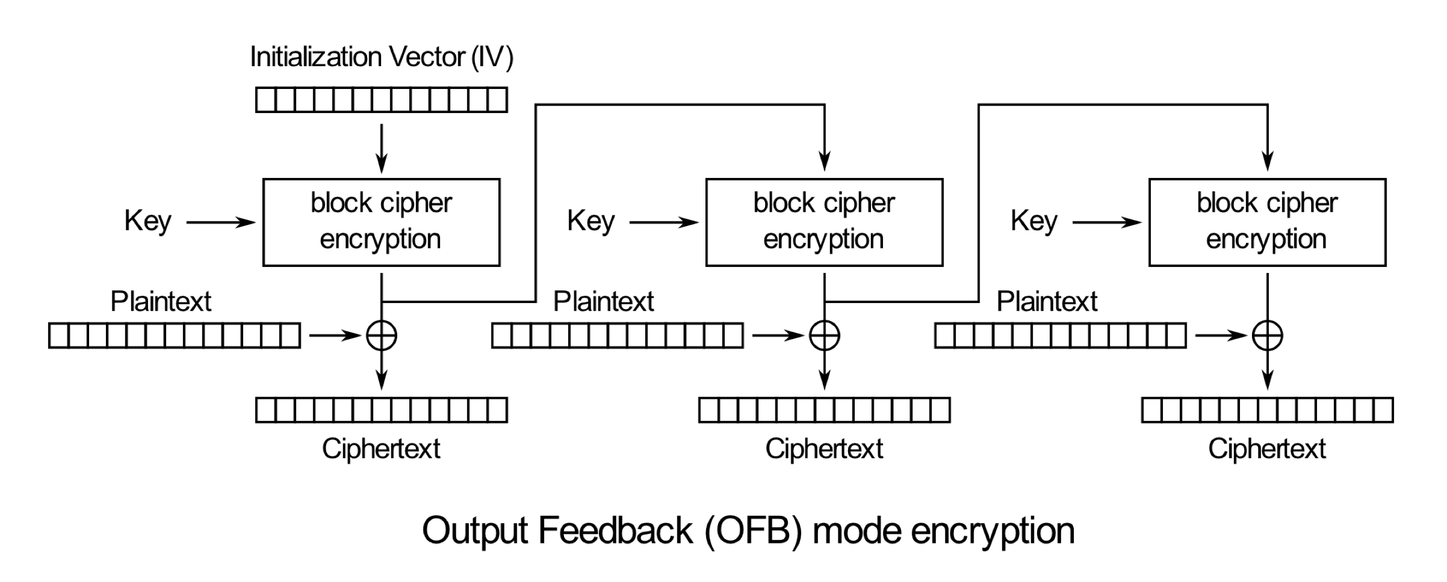
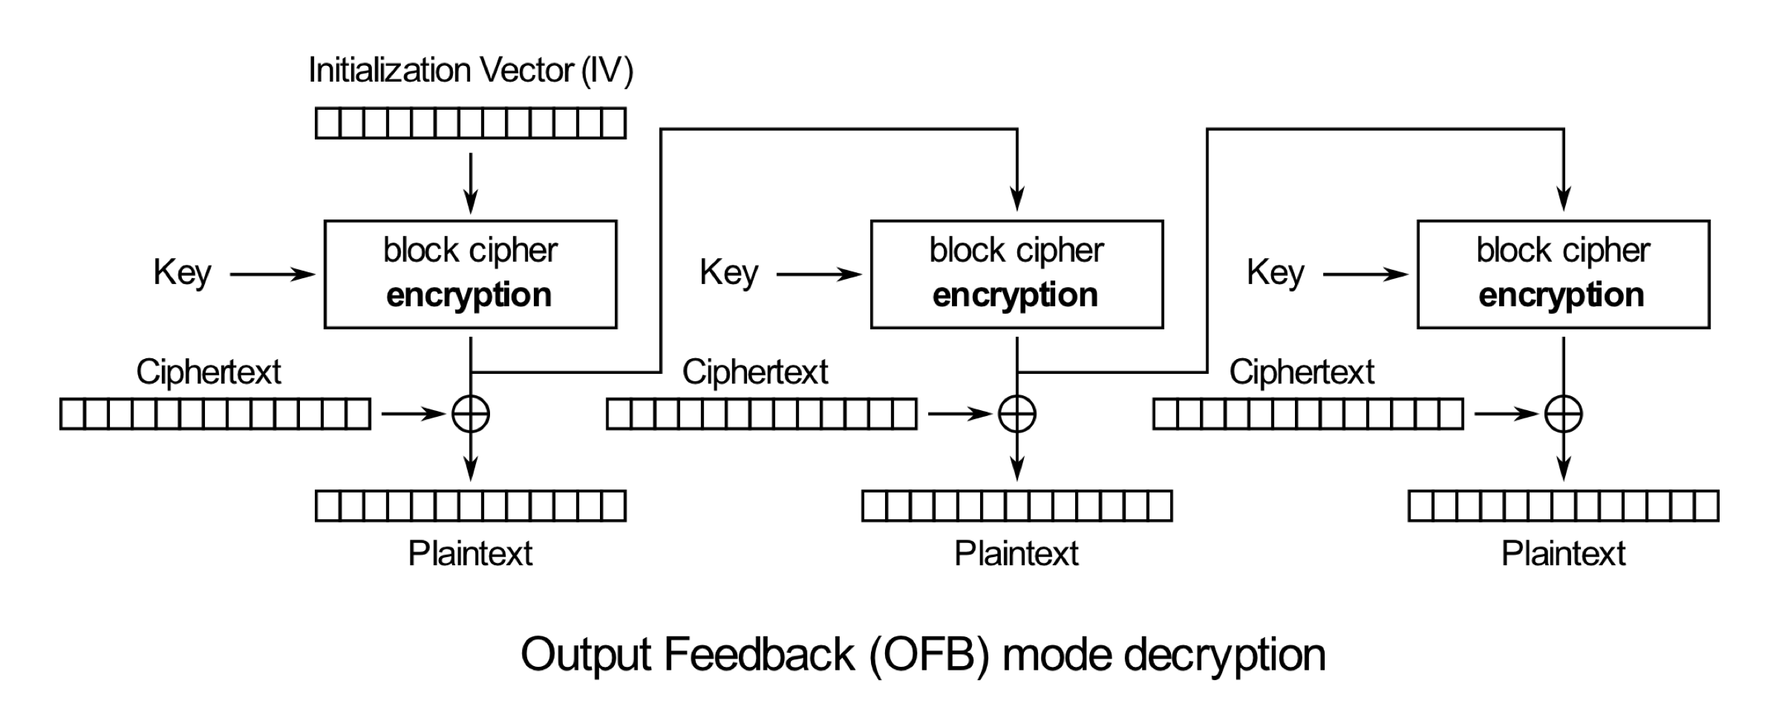
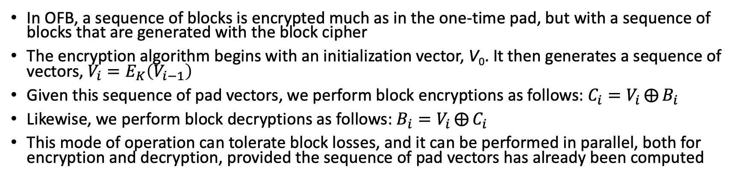
Output Feedback (OFB) Mode
In OFB, a sequence of blocks is encrypted much as in the one-time pad, but with a sequence of blocks that are generated with the block cipher
The encryption algorithm begins with an initialization vector, V₀. It then generates a sequence of vectors, $V_{i}=E_{K}\left(V_{i−1}\right)$
Given this sequence of pad vectors, we perform block encryptions as follows: $C_{i}=V_{i}⨁{B_{i}}$
Likewise, we perform block decryptions as follows: $B_{i}=V_{i}⨁{C_{i}}$
This mode of operation can tolerate block losses, and it can be performed in parallel, both for encryption and decryption, provided the sequence of pad vectors has already been computed
Source: https://en.wikipedia.org/wiki/Block_cipher_mode_of_operation

